Slide 1

2023 | 2024
Open Enrollment is Here!

Slide 2
Open Enrollment
Time of year employees and their dependents can make changes to their benefit plans offered through the City.
Benefit changes are required to be done through Bentek, our online enrollment system.
Remember to re-elect Flexible Spending Account (FSA) and update beneficiaries
Elections will be effective October 1, 2023.

Slide 3
Qualifying Event
You are committed to your elections for the next 12 months unless you experience a Qualifying Event, which may include:
  Marriage
  Divorce
  Birth/Adoption/Legal custody of a child
You can update Bentek with changes made due to a Qualifying Event
Human Resources must be notified within 30 days of the event in order to change coverage

Slide 4
Open Enrollment Highlights
Medical Coverage will remain with Florida Blue
  Teledoc with Florida Blue
  Blue 365 with Florida Blue
Dental Coverage will remain with Humana
Vision Coverage will remain with Humana
Flexible Spending will remain the same
Life and Disability will remain with Lincoln Financial
Short Term Disability (STD)
Long Term Disability (LTD)
EAP will remain change to Lincoln Financial
Allstate will remain the same
Legal Insurance will remain with U.S. Legal Services

Slide 5
Medical – Florida Blue Plan
Medical Service | In-Network |  | Out of Network
Deductible (PYD) | Single: $1,500 Family: $3,000 |  | Single: $3,000 Family: $6,000
Out of Pocket Max | Single: $4,500 Family: $6,850 Per Person $9,000 Per Family |  | Single: $9,000 Family: $18,000 Per Person $18,000 Per Family
Physician Office Visit (PCP) | 20% After PYD |  | 40% After PYD
Specialist Office Visit | 20% After PYD |  | 40% After PYD
Advanced Imaging (MRI, CT, PET) | 20% After PYD |  | 40% After PYD
Inpatient Hospitalization | Option 1: 20% After PYD | Option 2: 25% After PYD Per Person 20% After PYD Per Family | $500 PAD 40% After PYD
Outpatient Hospitalization | Option 1: 20% After PYD | Option 2: 25% After PYD | 40% After PYD
Emergency Room | 20% After PYD |  | 20% After PYD
Urgent Care | 20% After PYD |  | 40% After PYD
Quest is the network lab for Florida Blue
HRA Funding $2500 EE Only and $5000 Family
Deductible is shared for all individuals in a family

Slide 6
Medical – Rx Coverage
Tier | In Network | Out of Network
Tier 1 | $10 Copay After PYD | In-Network PYD + 50%
Tier 2 | $30 Copay After PYD
Tier 3 | $50 Copay After PYD
Mail Order (90 days) | 2.5 Copays After PYD | Not Covered Amazon - Register
Notes:
Added place holder for new plan RX comparision

Slide 7

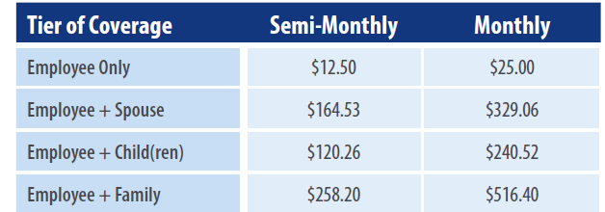
Medical Payroll Deductions for 2023-24
No Change for Employee Contribution
Total Cost of Each Plan
$661.54
$1,508.30
$1,323.07
$2,116.91
Notes:
Leaving a place holder for new rates and additional plan

Slide 8
Teledoc
On demand visits with Doctors
24/7/365 , mobile app, web or phone request
Members can get resolution for a large range of health issues, cold, flu, cough, pink eye, allergies and more
Visits will post to member’s file and be sent to the member’s PCP
Pre-register Now before you need it!

Slide 9

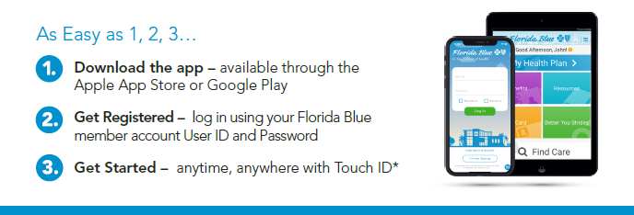
Florida Blue Mobile App
  Download the Mobile App
3

Slide 10
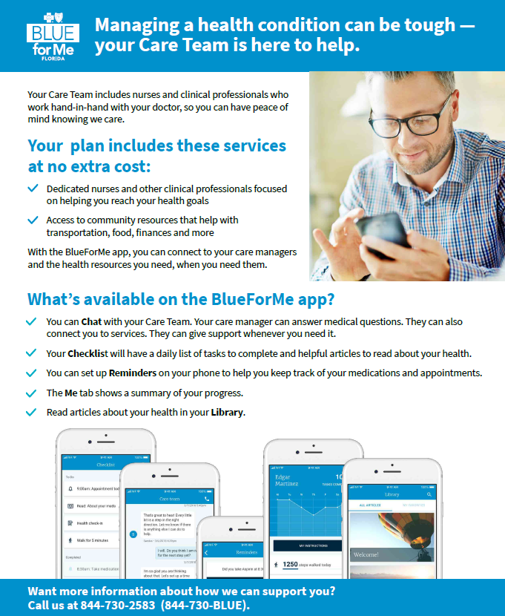
3

Slide 11

3

Slide 12
Health Reimbursement Account
The city will contribute to HRA accounts for employees who participate in the Florida Blue medical plan
Eligible expenses must be necessary for the diagnosis, treatment, cure, or prevention of a specific medical condition.
$2500 for employees with individual coverage
$5000 for employees that cover a spouse and/or children
www.BenefitsWorkshop.com/sebastian
Notes:
Add QR Code

Slide 13
Benefits Workshop HRA
    Create your HRA account with BenefitsWorshop at
    www.benefitsworkshop.com/Sebastian
      Reminder: Be careful to utilize the HRA username and password as it differs from your FSA username and password, if you have both accounts.
    2022-2023
    If you have expenses that occurred in 2022-2023 and need to submit to BenefitsWorkshop in 2023-2024, please do so with a paper claim form via email or fax. If you have any questions call (888) 537-3539. This will assure the funds are taken out of the correct plan year of your account.
9

Slide 14
Humana Dental PPO
Services | In Network | Out of Network
Calendar Year Deductible | $50/$150
Calendar Year Benefit Maximum | $1,000
Class I: Diagnostic & Preventive Services | Plan Pays 100% Deductible Waived | Plan Pays 100% Deductible Waived
Routine Oral Exams & Cleanings
Class II: Basic Services | Plan Pays 80% after CYD | Plan Pays 80% after CYD
Fillings (Amalgam) & Simple Extractions
Class III: Major Services | Plan pays 50% after CYD | Plan Pays 50% after CYD
Crowns & Dentures
Class IV: Orthodontia
Lifetime Maximum | $1,000
Benefit –Children through age 18 | Plan Pays 50% | Plan Pays 50%
Must register on MyHumana.com for dental ID cards
Diagnostic and preventive services do not accumulate towards the benefit maximum

Slide 15
Buy-Up Humana Dental PPO
Services | In Network | Out of Network
Calendar Year Deductible | $50/$150
Calendar Year Benefit Maximum | $1,500
Class I: Diagnostic & Preventive Services | Plan Pays 100% Deductible Waived | Plan Pays 100% Deductible Waived
Routine Oral Exams & Cleanings (2 per year)
Class II: Basic Services | Plan Pays 80% after CYD | Plan Pays 80% after CYD
Fillings (Amalgam) & Simple Extractions
Class III: Major Services | Plan pays 50% after CYD | Plan Pays 50% after CYD
Crowns & Dentures, Bridges, Dentures Periodontics, root canals
Class IV: Orthodontia
Lifetime Maximum | $1,000
Benefit –Children through Age 18 | Plan Pays 50% | Plan Pays 50%
Must register on MyHumana.com for dental ID cards
Diagnostic and preventive services do not accumulate towards the benefit maximum

Slide 16
Dental Payroll Deductions
Tier of Coverage | Humana Dental PPO - Base Plan Semi-Monthly | Humana Dental PPO Buy-Up Plan Semi-Monthly
Employee Only | $0.00 | $3.42
Employee + Spouse | $8.21 | $15.11
Employee + Child(ren) | $14.28 | $23.76
Employee + Family | $22.48 | $35.44

Slide 17
Vision Plan – Humana
Services | Humana Vision Network | Non-Network
Eye Exam (12 months) | $10 Copay | Up to $30 Allowance
Contact Lens standard Exam (12 month)
 | Up to $55 | Not covered
Lenses (12 months)
Single | $15 Copay | $25 Allowance
Bifocal |  | $40 Allowance
Trifocal |  | $60 Allowance
Frames (24 months) | $130 Allowance + 20% discount | $65 Allowance
Contact Lenses (in lieu of spectacle lenses and a frame) | $130 Allowance + 15% discount | $104 Allowance
Medically Necessary | No Charge | $200 Allowance
www.humana.com

Slide 18
Vision Payroll Deductions
Tier of Coverage | Humana Vision
Employee Only | $0.00
Family | $1.88

Slide 19
Vision Plan – Humana

Slide 20
Flexible Spending Accounts
Health Care Reimbursement Account
Annual maximum $3,050
Money will not be taxable income
Used to offset the cost of a wide variety of eligible health expenses that generate out of pocket costs to you and your qualified dependents.
$570 Rollover
Reimbursed for qualified expenses set forth by the I.R.S.
Entire Health Care FSA election is available to you on the first day coverage is effective
Sample list of qualified eligible expenses are listed in your Employee Benefit Handbook .
FSA Store
Dependent Care Reimbursement Account
Annual Maximum of $5,000 if you are single or married and file a joint tax return ($2,500) if you are married and file a separate tax return)
Work-related day care expenses
Qualified expenses include adult and child day care centers, preschool, and before/after school care for eligible children and adults
Unlike Health Care FSA, you will only be reimbursed up to the amount that has been deducted from your paycheck
Notes:
Confirm the limits

Slide 21
Basic Life and AD&D – Lincoln Financial
Basic Life and AD&D
  Provided by the city at no cost to Full-Time employees working a minimum of 30 hours per week
  $15,000 Life and AD&D Benefit
  Update Beneficiaries as needed

Slide 22
Voluntary Life Insurance
Lincoln Financial
Employee
  Increments of $10,000 to a maximum of 5 times salary not to exceed $500,000.
  Employees can add up to 20K / 10K for spouses without EOI
  Reduction in benefit at age 65
Spouse
  Employee must apply
  Increments of $5,000 up to 50% of employee amount
Dependent Children
  Employee must apply
  $10,000 Benefit Amount
Rates vary depending on age and benefit
Evidence of Insurability is required if current employee and newly enrolling
EOI must be done online not on paper as before

Slide 23
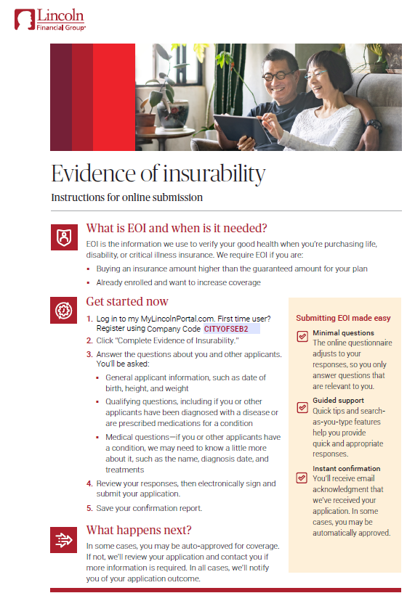

Slide 24
Short Term Disability – Lincoln Financial
Eligible: All employees who work over 30 Hours per week
Weekly Benefit: 60% of Weekly Earnings
To make up the remaining 40% you may use your available sick time then vacation
Weekly Maximum Benefit: $1,500
Benefit Waiting Period: 7 Calendar Days for Accident and Sickness
Duration of Benefit: 13 Weeks
Process: Request FMLA Forms for the illness/accident
Short Term Disability Claim Includes completing:
Employer Information; Copy of Job Description
Employee Information
Physician Statement
Authorization for Release of Additional Medical Information
Intake Options
Telephonic Intake (866-STD-CALL) –Preferred method – speak to a representative – 7 a.m. to 7 p.m. CST Mon-Thurs; 7 a.m. to 5 p.m. Fri. Turnaround time: 24 business hours
Email – Disabilityclaims@lfg.com Turnaround time: 24 business hours
Mail – The Lincoln National Life Insurance Co., PO Box 2609, Omaha, NE 68103 – 3 business days
FAX: 800-922-3503 - within 3 business days

Slide 25



LINCOLN FINANCIAL Value-added benefits included
  TravelConnectSM services
  LifeKeys® services
  EmployeeConnectSM services
Emergency travel arrangements
Free emergency medical help
Medical evacuation repatriation
Free online will preparation
Memorial planning information
Grief counseling
for beneficiaries
Legal and financial information
6 face to face counseling sessions included
Financial consultations & referrals
Phone access to legal & work-life services

Slide 26
Disability – Lincoln Financial
Long Term Disability (LTD)
  Provided by the city at no cost to Full-Time employees who have completed one year of uninterrupted service
  60% of monthly earnings up to $5,000
  90-day elimination period

Slide 27
Employee Assistance Program (EAP)
www.guidanceresources.com ( Lincoln )
Provided by the city at no cost to the employee
Fully confidential
24 hours a day/7 days a week
Licensed Mental Health Professionals
Help address a variety of problems:
  Anxiety
  Depression
  Stress
  Legal and financial concerns
  Grief and bereavement

Slide 28
Other Benefits Offered:
Allstate Products:
Contact Agent Artie Hoffman (954) 609-4924
Accident
Hospital
Critical Illness
Cancer plans
US Legal Services
Contact Agent Dixie Kuehn (321) 799-2986
Family Defender & Identity Defender coverages

Slide 29
Bentek
Open Enrollment Period:
Thursday, August 17th- Sunday, Aug. 27th
  Log onto Bentek: www.mybentek.com/Sebastian
  Confirm personal information
  Confirm Elections / Make Changes
  Make your annual FSA Election
  If adding a NEW Dependent, you will need Dependent SSN (Upload necessary documentation on Bentek or deliver to your HR Department)
  Assign / Update Beneficiaries for Life Insurance – Married, Divorce, other life events
Bentek Support or Questions
  (888) 523-6835, Monday through Friday from 8:30am – 5:00pm
Notes:
Revise dates

Slide 30

Bentek Landing Page

Slide 31
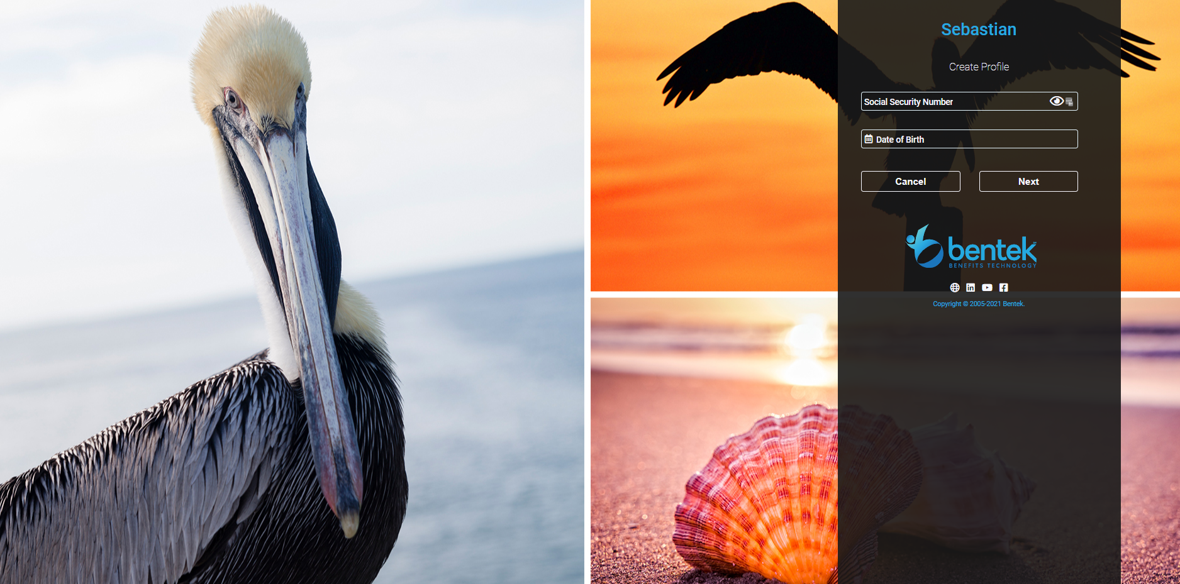


Bentek – Create Profile

Slide 32
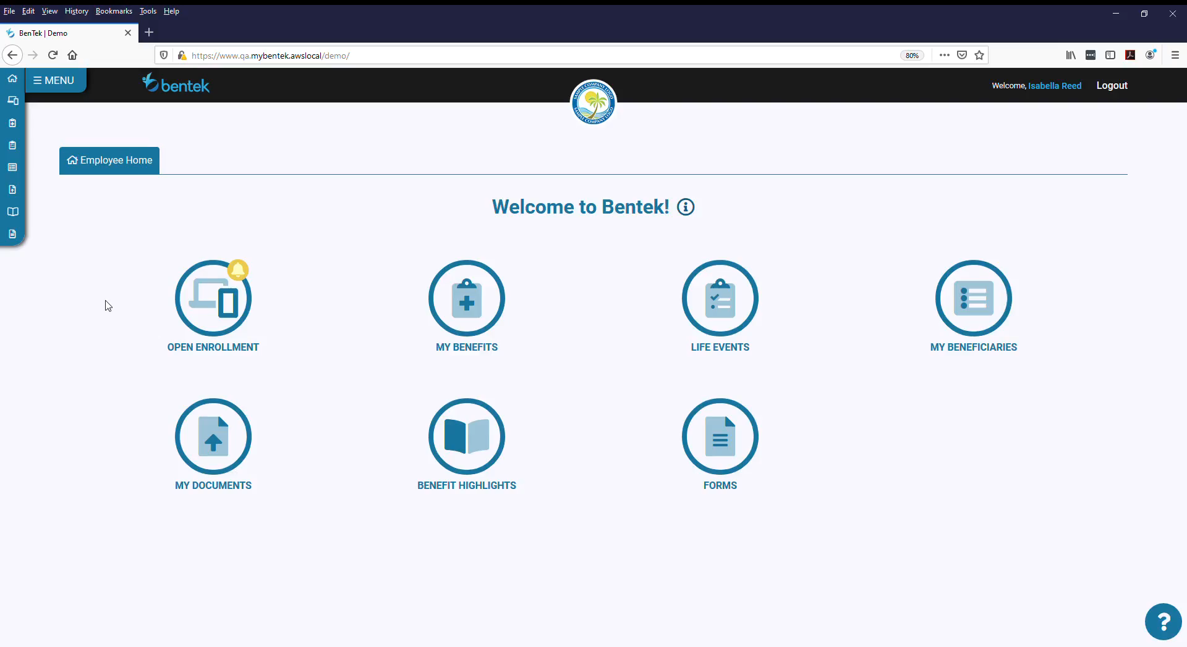
Bentek

Slide 33
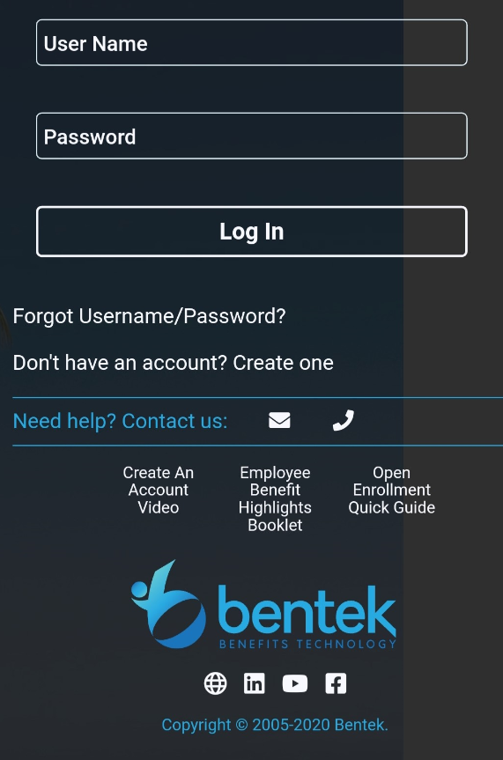
Bentek Online & Mobile Enrollment
Enroll in your benefits at your convenience throughout Open Enrollment
Click on Menu Option at top left of the page and click Open Enrollment to begin
Review current elections
Make any elections or make changes including life insurance beneficiary designations
Click “submit” to ensure your elections are confirmed in Bentek
Deadline to make changes is Sunday, Aug. 27, 2023 (Midnight)
Elections to be effective October 1, 2023
www.mybentek.com/Sebastian
Notes:
Available via mobile devices

Slide 34
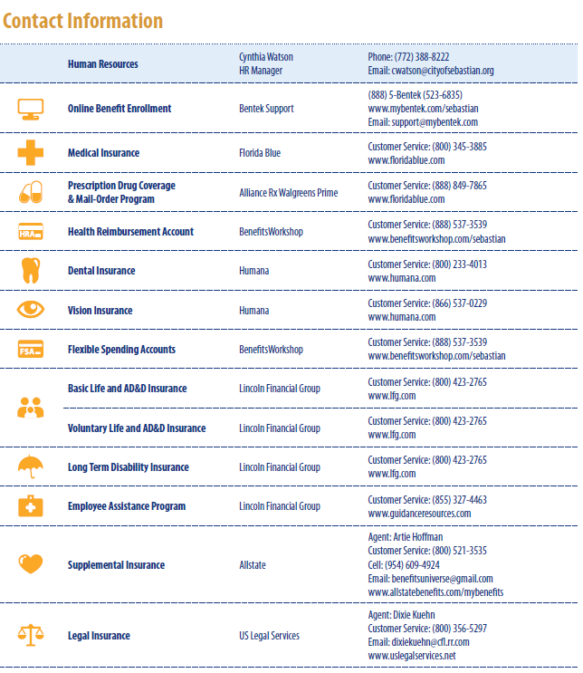
Questions? Employee Benefit Booklet

Slide 35
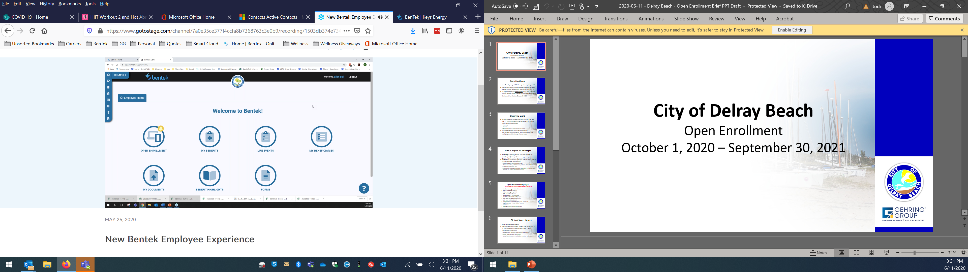
Bentek – Launchpad

Slide 36
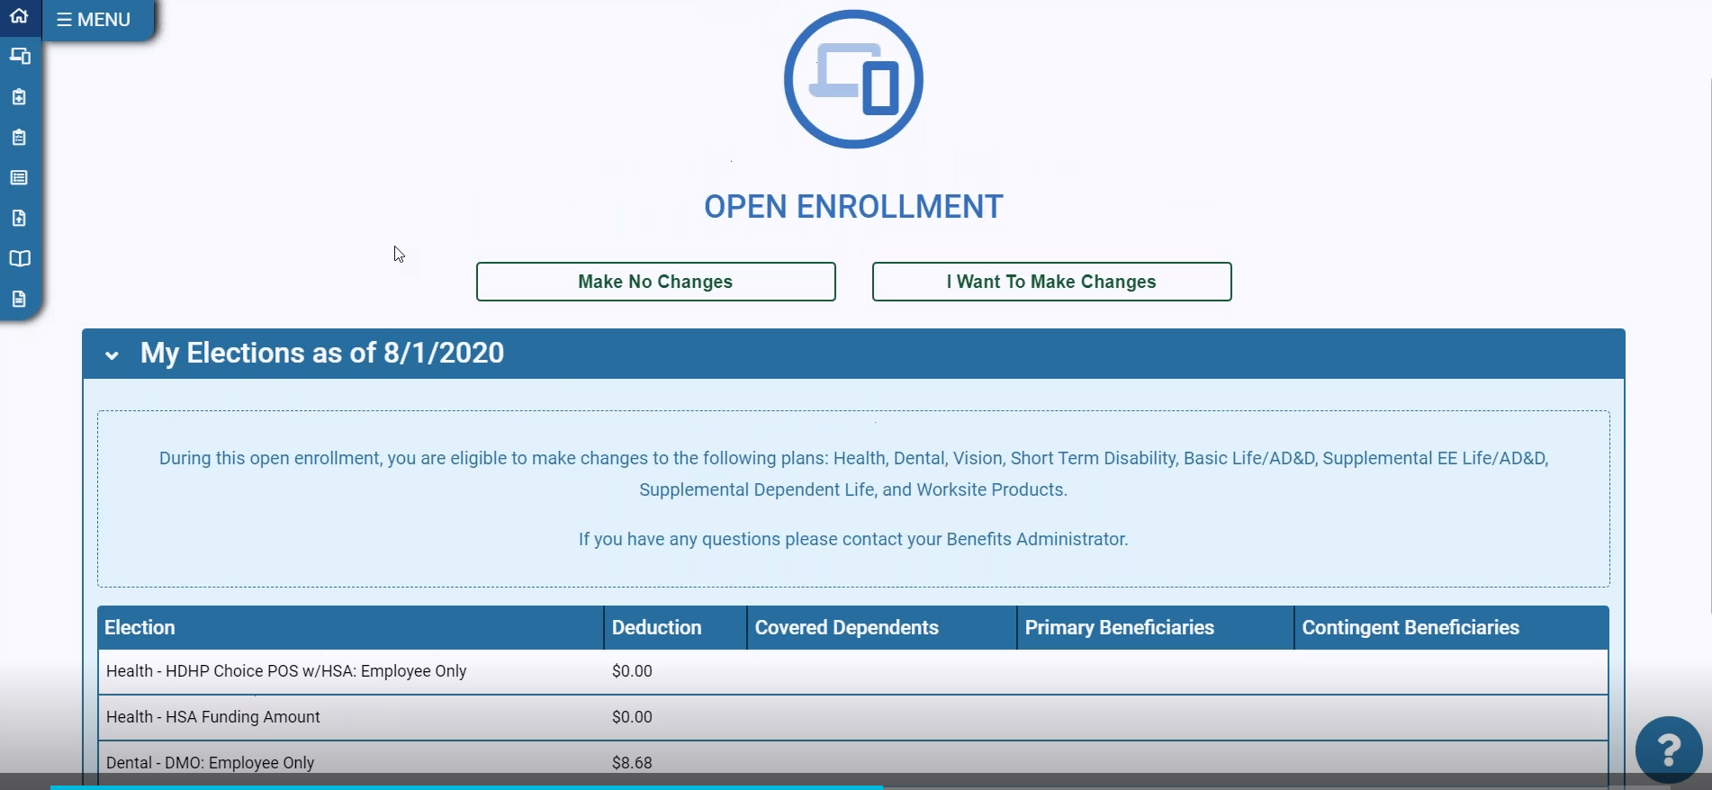
No Changes or Make Changes
NEW

Slide 37
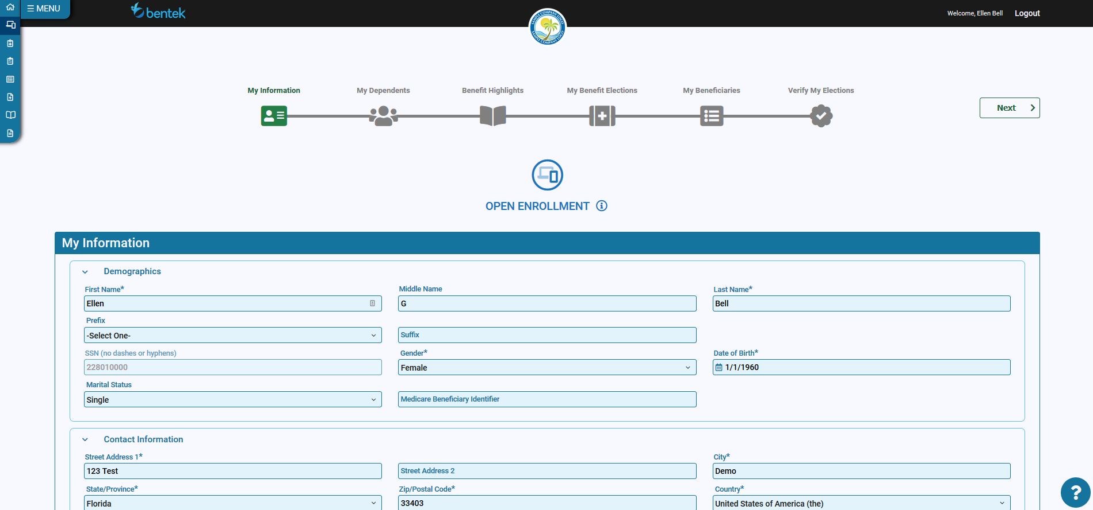
6 Clicks to Enrollment

Slide 38
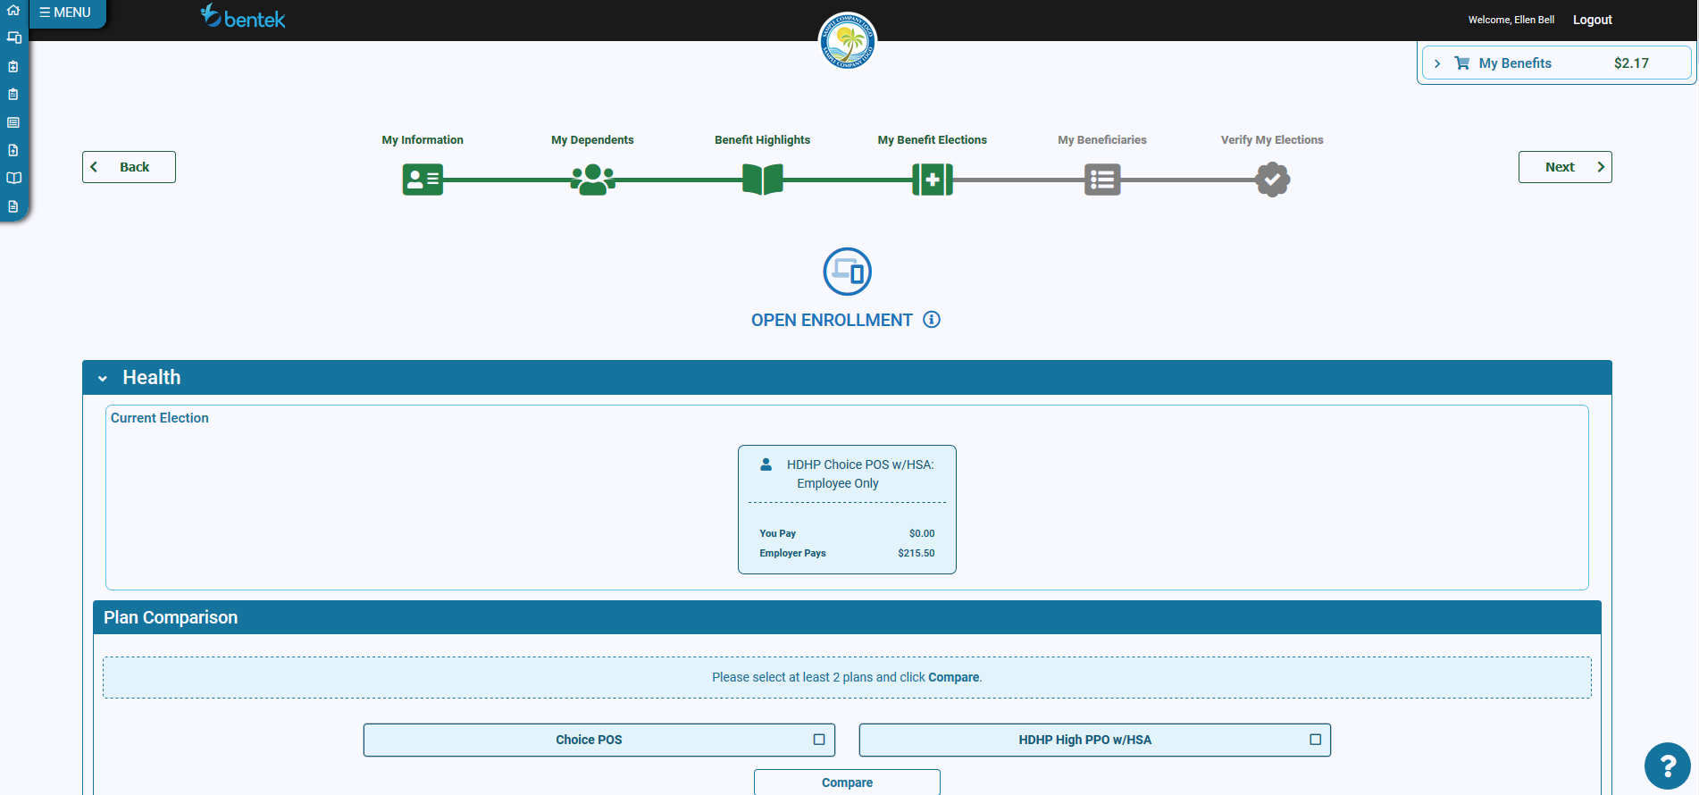
Bentek-Benefit Elections
New Look

Slide 39
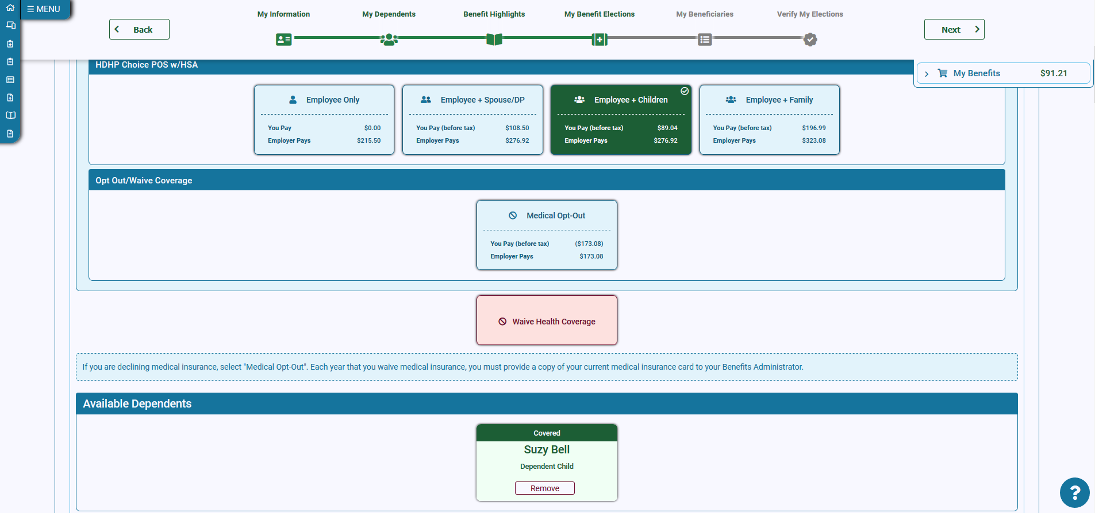
Bentek – My Benefit Elections - Benefits Cart
Notes:
Shows benefits cart with the drop down

Slide 40
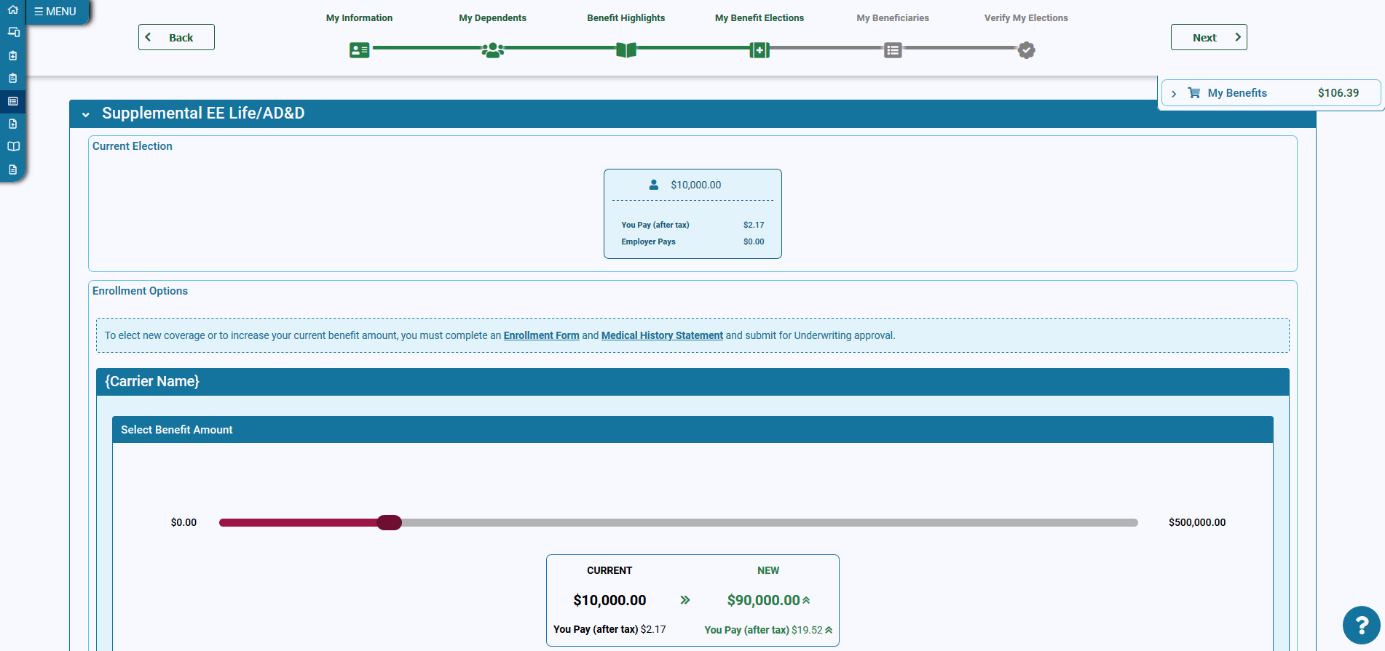
Life Insurance
Notes:
Shows benefits cart with the drop down

Slide 41
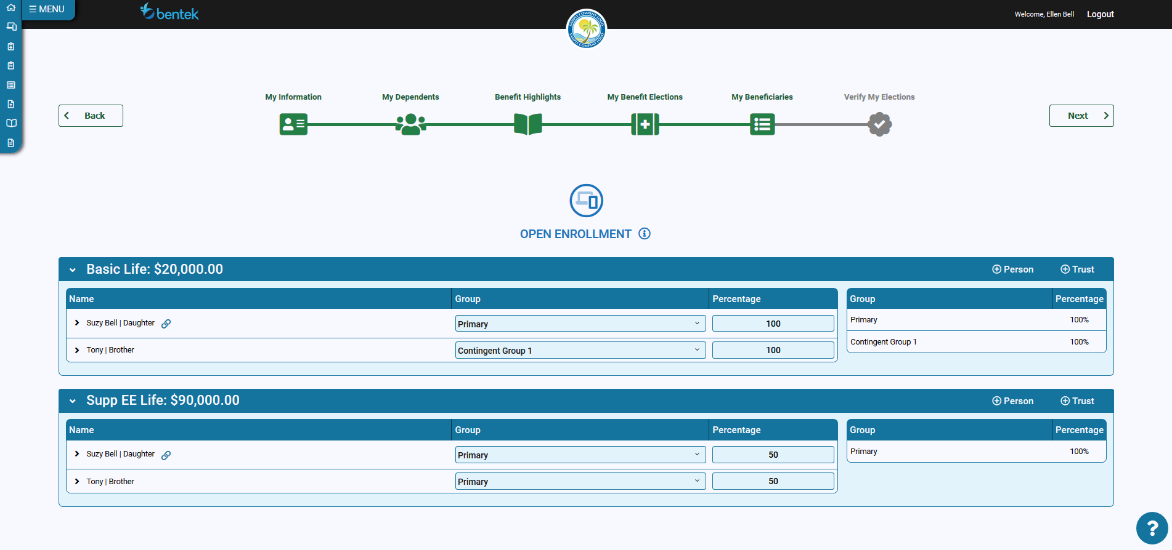
Bentek – My Beneficiaries
Notes:
Dependents are listed in beneficiary section, however, you must designate the actual beneficiaries and percentage

Slide 42
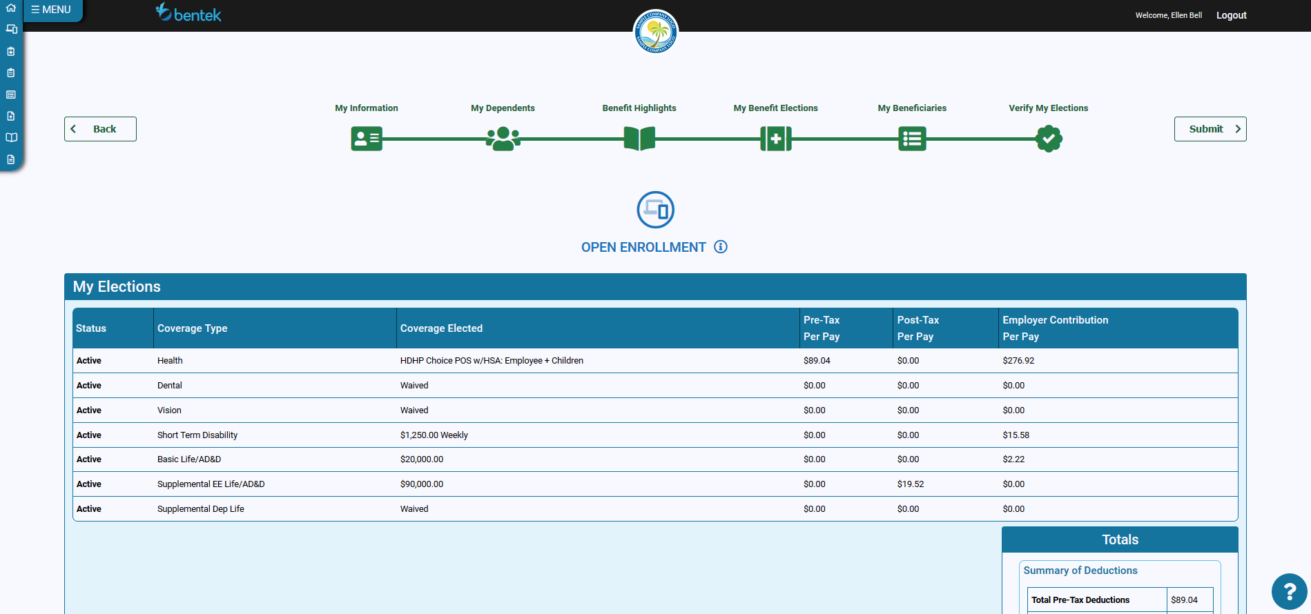
Bentek – View My Elections, Agree and Submit
Notes:
View your elections
Scroll down and click agree
Click submit, upper right

Slide 43
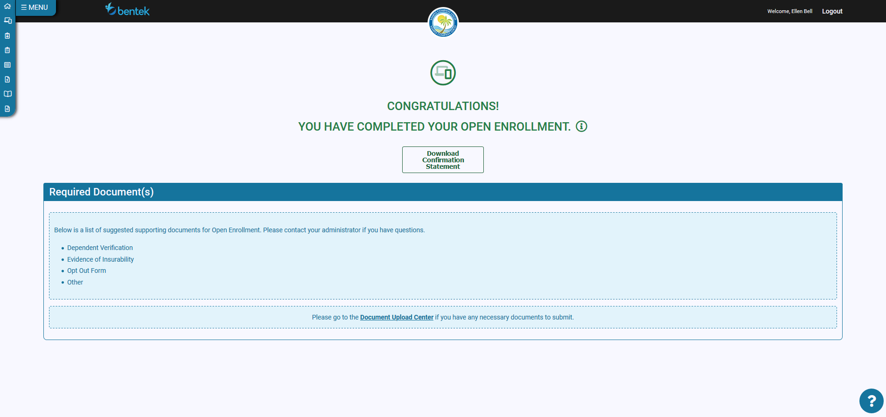
Bentek – Congratulations!
Notes:
Download and Print confirmation statement

