Slide 1
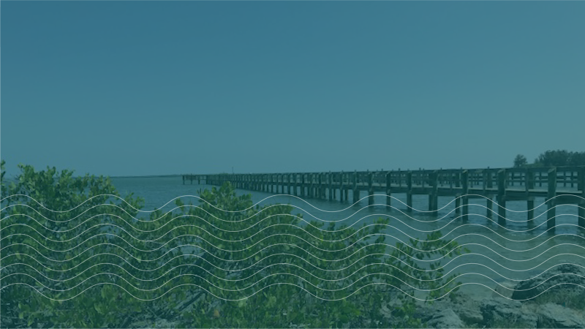
2. Transportation & Mobility Element

Slide 2
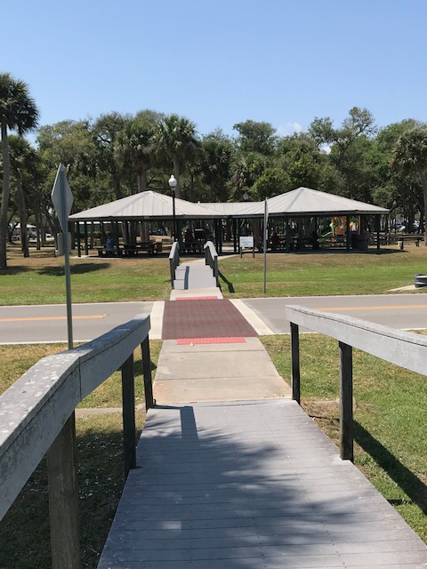
Transportation & Mobility Element
What is the Transportation & Mobility Element?
Assesses the condition and capacity of the existing transportation facilities, projects future needs, sets LOS standards for roads, and determines future system improvements
Recognizes the need to provide transportation alternatives to increase accessibility and provide a comprehensive transportation system

Slide 3
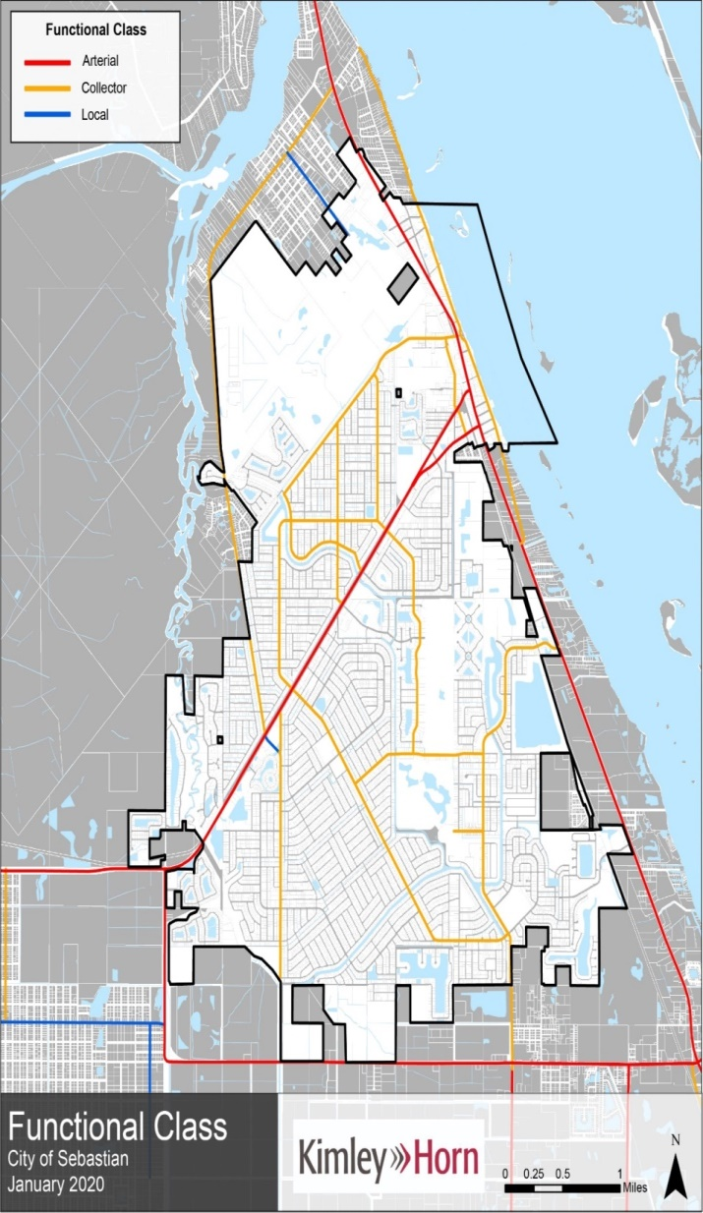
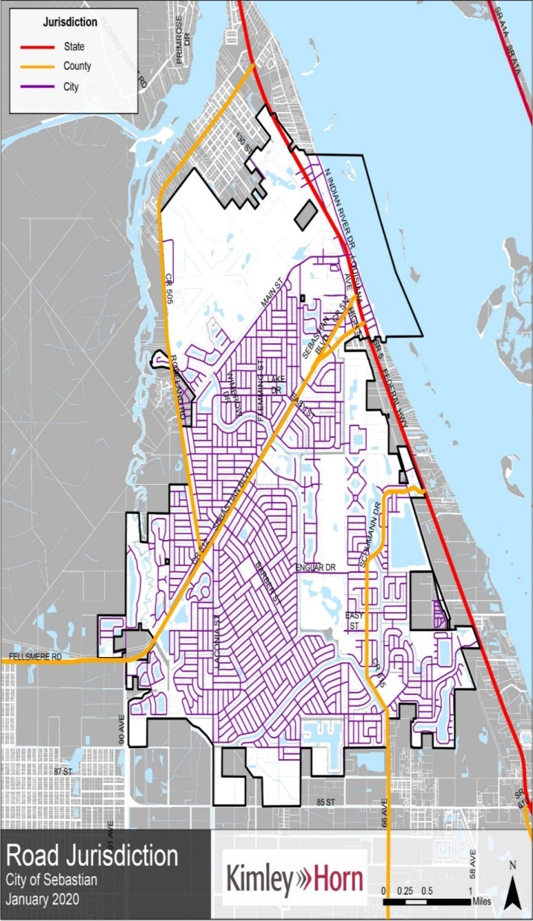
Transportation & Mobility DIA Updates
Functional Class
  Arterial
  Collector
  Local
Road Jurisdiction
  State
  County
  City

Slide 4
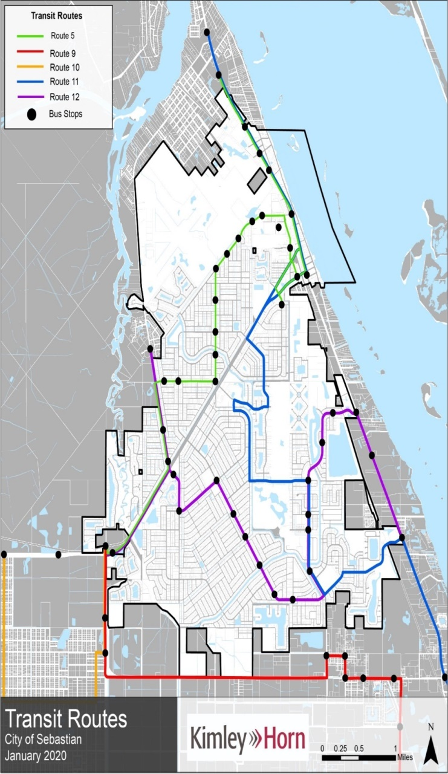
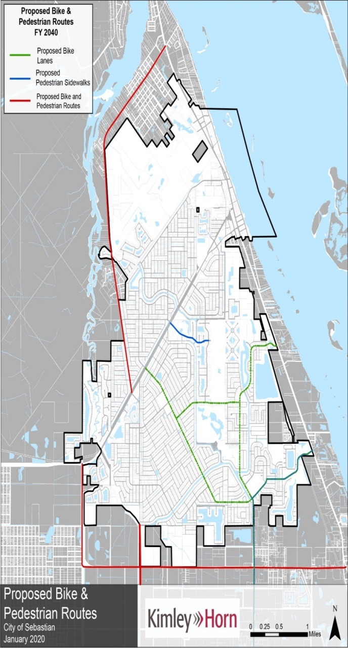
Transportation & Mobility DIA Updates
Transit Routes
  5 routes
Proposed Bike & Pedestrian Routes
  Through planning period

Slide 5
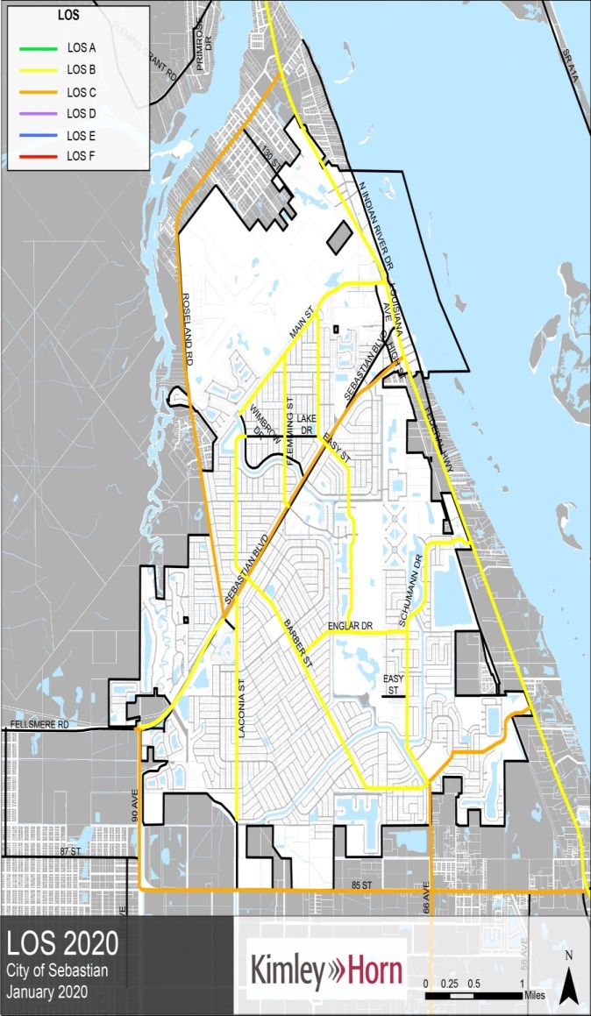
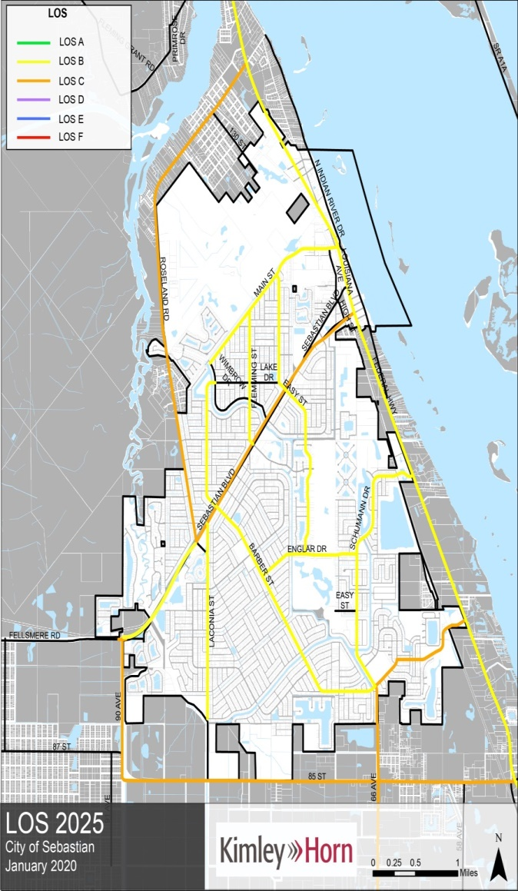
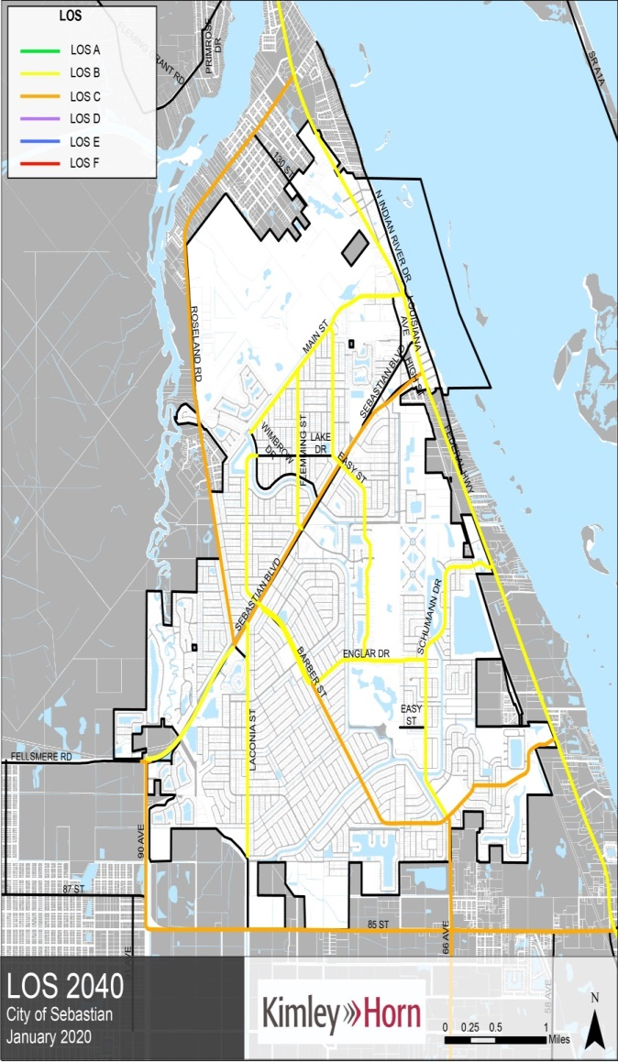
Transportation & Mobility DIA Updates
Level of Service (LOS)

Slide 6
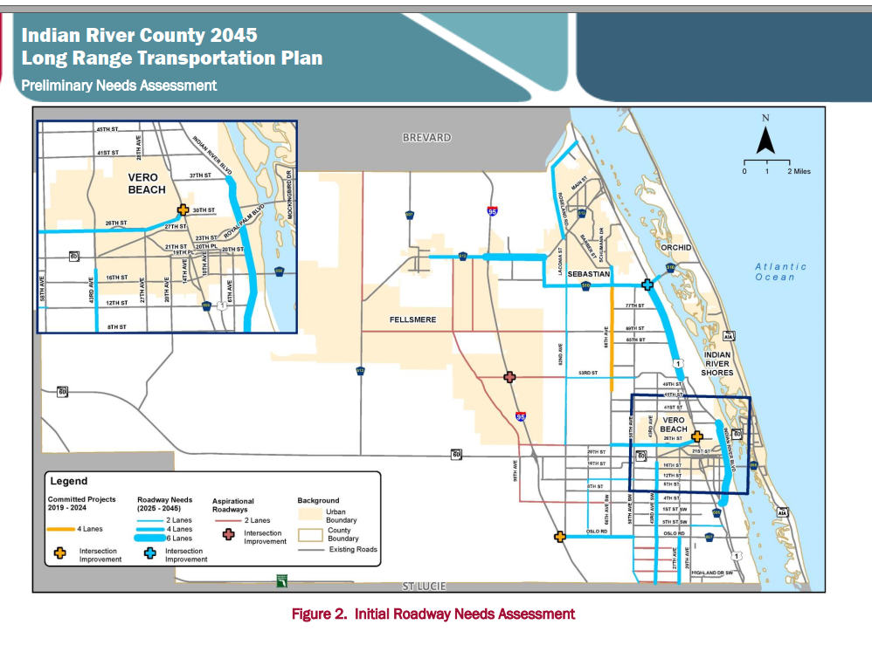
IRC TIP

Slide 7
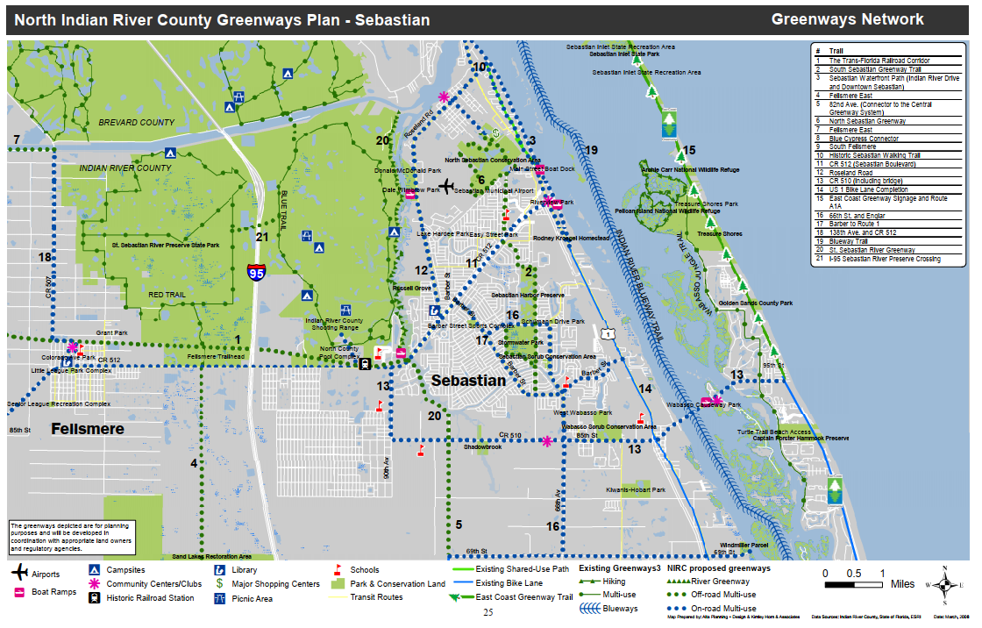
North County Greenways Plan

Slide 8
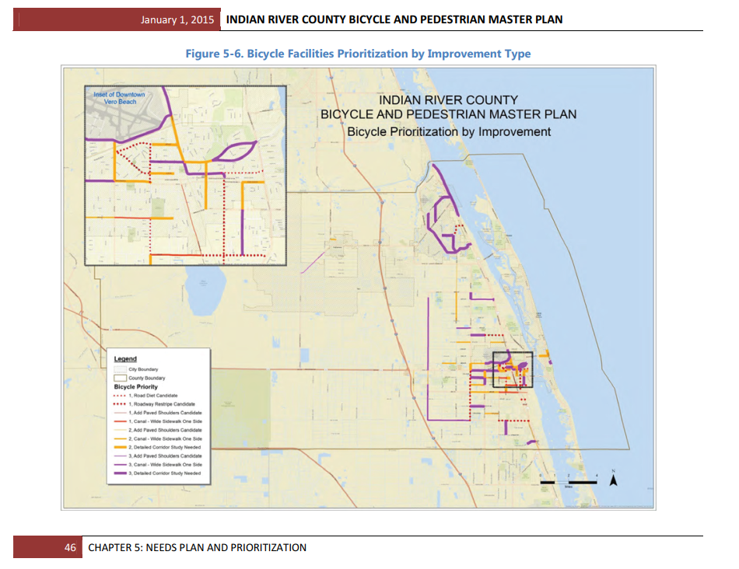
IRC Bicycle Prioritization Plan

Slide 9
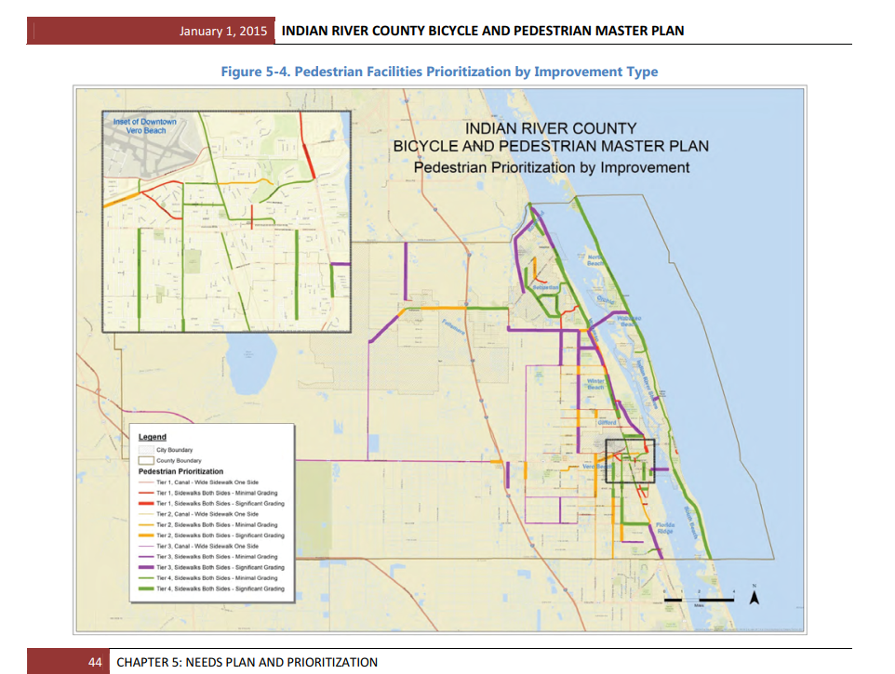
IRC Pedestrian Prioritization Plan

Slide 10
Transportation& Mobility GOPs Updates
Proposed Changes/Policy Decisions Overview
Added Prioritizing Policy (Policy 2-1.1.3)
Added Connection Policy (Policy 2-1.1.4)
Added Parking Policy (Policy 2-1.1.14)
Added Environmental Impact Policy (Policy 2-1.1.19)
Added Safety Objective and Polices (Objective 2-1.2)
Added Design Policy (Policy 2-1.4.2) and Roadway Standards Policy (Policy 2-1.5.6)
Added Traffic Calming Policy (Policy 2-1.6.11)

Slide 11
Transportation & Mobility GOPs Updates
Policy Decision: Added a Prioritizing Policy (Policy 2-1.1.3)
  Why? Prioritize mobility with consideration to sustainability, environmental, social, accessibility and equity factors
Proposed:
Where adequate facilities exist for all modes, enhancing the quality and integration of the facilities will be prioritized based on the hierarchy of modes
Provides a sustainable mobility hierarchy as a guideline for prioritizing projects based on transportation mode

Slide 12
Transportation & Mobility GOPs Updates
Policy Decision: Added Connection Policy (Policy 2-1.1.4)
  Why? Provide for increased mobility options
Proposed:
Policy 2-1.1.4: Connection. Implement land use strategies that support “park once environments”, increase vehicular trip capture, reduce vehicle dependence, promote non-vehicular travel, and decrease vehicle-miles-traveled (VMT), through development of mixed-use projects by requiring vehicular and pedestrian interconnection between adjacent properties, and by providing connections to transit facilities.

Slide 13
Transportation & Mobility GOPs Updates
Policy Decision: Added Parking Policy (Policy 2-1.1.14)
  Why? Reflect parking trends and needs
Proposed:
Policy 2-1.1.14: Parking. The City shall regularly analyze, assess, and update parking requirements in the LDC to reflect actual parking trends and needs. Parking requirements may be customized for various parts of the City.

Slide 14
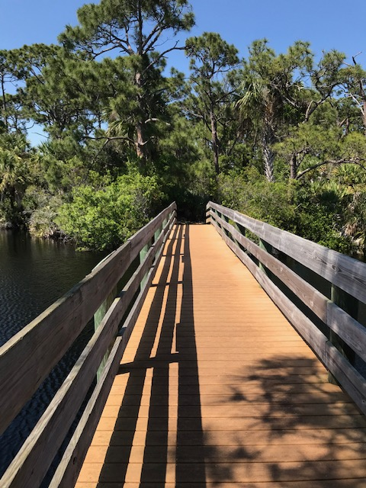
Transportation & Mobility GOPs Updates
Policy Decision: Added Environmental Impact Policy (Policy 2-1.1.19)
  Why? Minimize the impacts on the environment
Proposed:
Policy 2-1.1.19: Environmental Impact. The City shall implement standards in the LDC that minimize the impacts of mobility infrastructure on the environment.

Slide 15
Transportation & Mobility GOPs Updates
Policy Decision: Added Safety Objective and Polices (Objective 2-1.2)
  Why? Emphasize safety including the reduction of crashes involving those walking, riding a bicycle, riding or driving transit and other vehicles
Proposed:
Strive to design roadways that meet the desired speed
Promote traffic calming design standards on roadways that share a multi-modal component
Review proposed development and redevelopment and reduce the number of driveways where possible. As properties are developed or redeveloped encourage the use of connecting commercial parking areas to reduce the number of driveways
Maintain a record of traffic counts and traffic related crashes for major roadways in the City’s network and update those records on an annual basis

Slide 16
Transportation & Mobility GOPs Updates
Policy Decision: Added Design Policy (Policy 2-1.4.2) and Roadway Standards Policy (Policy 2-1.5.6)
  Why? Require roadway design that meets FDOT Design Manual standards
Proposed:
Policy 2-1.4.2: Design. The City will coordinate with FDOT on roadway design meeting the FDOT Design Manual standards.
Policy 2-1.5.6: Roadway Standards. Proposed developed will be reviewed to include appropriate roadway standards to include bicycle and pedestrian facilities based on the FDOT Design Manual. Shade trees should also be encouraged with new development.

Slide 17
Transportation & Mobility GOPs Updates
Policy Decision: Added Traffic Calming Policy (Policy 2-1.6.11)
  Why? Traffic calming measures on public roadways
Proposed:
Policy 2-1.6.11. Traffic Calming. The City shall consider developing a technical traffic calming manual identifying measures for prioritization and implementation of traffic calming measures on public roadways.

Slide 18
Transportation & Mobility Element
Questions?

